Slide 1
Box-and-Whisker Plots

Slide 2
A box plot summarizes data using the median, upper (Q3) and lower (Q1) quartiles, and the extreme (least and greatest) values. It allows you to see important characteristics of the data at a glance.
Box and Whisker Plots

Slide 3
The 5 Number Summary
The five number summary is another name for the visual representation of the box and whisker plot.
The five number summary consist of :
The median ( 2nd quartile)
The 1st quartile/Lower Quartile
The 3rd quartile/Upper Quartile
The maximum value in a data set
The minimum value in a data set

Slide 4
Box Plots
Anatomy of a Box and Whisker Diagram.
Lower Quartile
(Q1)
Upper Quartile (Q3)
Lowest Value
Median
Highest Value
Whisker
Box
Whisker
4
5
6
7
8
9
10
11
12

Slide 5
Analyzing a Box-and-Whisker Plot
25%
25%
25%
25%
50%
50%

Slide 6


Step 1 – Order Numbers
1. Order the set of numbers from least to greatest

Slide 7
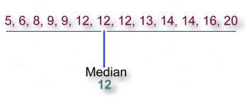
Step 2 – Find the Median
2. Find the median. The median is the middle number. If the data has two middle numbers, find the mean of the two numbers. What is the median?

Slide 8
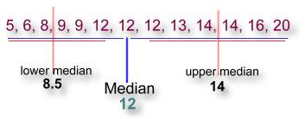
Step 3 – Upper & Lower Quartiles
3. Find the lower and upper medians or quartiles. These are the middle numbers on each side of the median. What are they?

Slide 9

Step 4 – Draw a Number Line
Now you are ready to construct the actual box & whisker graph. First you will need to draw an ordinary number line that extends far enough in both directions to include all the numbers in your data:

Slide 10

Step 5 – Draw the Parts
Locate the main median 12 using a vertical line just above your number line:

Slide 11

Step 5 – Draw the Parts
Locate the lower median 8.5 and the upper median 14 with similar vertical lines:

Slide 12

Step 5 – Draw the Parts
Next, draw a box using the lower and upper median lines as endpoints:

Slide 13

Step 5 – Draw the Parts
Finally, the whiskers extend out to the data's smallest number 5 and largest number 20:

Slide 14
Step 6 - Label the Parts of a Box-and-Whisker Plot
Lower Quartile
Median
Upper Quartile
Lower Extreme
3
1
2
Upper Extreme
4
5
Name the parts of a Box-and-Whisker Plot

Slide 15
How to find the: Inter-Quartile Range
Inter-Quartile Range – the difference between the upper and lower quartile of a set of data.
Inter-Quartile Range = Upper Quartile – Lower Quartile
Show where you could find the inter-quartile range on the
box-and-whisker plot below:
INTER-QUARTILE RANGE

Slide 16
Interquartile Range
The interquartile range is the difference between the upper quartile and the lower quartile.
14 – 8.5 =
5.5

Slide 17
Shape
Symmetry: Is the shape of the distribution symmetric, that is, is the shape similar either side of a central axis (like a mirror image)? Or is the shape skewed, that is, asymmetric?
Number of peaks: Distributions can have few or many peaks. Distributions with one clear peak are called unimodal (one mode), and distributions with two clear peaks are called bimodal (two modes). Distributions with more than two clear peaks are called multimodal (three or more modes). When a symmetric distribution has a single peak at the center, it is referred to as bell-shaped.

Slide 18
Shape
Skewness: When they are displayed graphically, some distributions have many more observations on one side of the graph than the other. Distributions with fewer observations on the right (toward higher values) are said to be skewed right; and distributions with fewer observations on the left (toward lower values) are said to be skewed left.
Uniform: When the observations in a set of data are equally spread across the range of the distribution, the distribution is called a uniform distribution. A uniform distribution has no clear peaks.

Slide 19
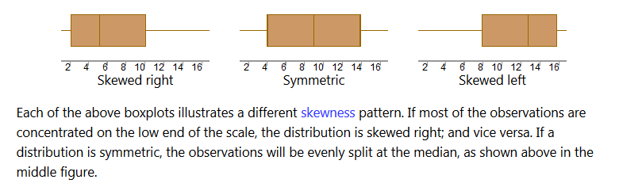

Slide 20
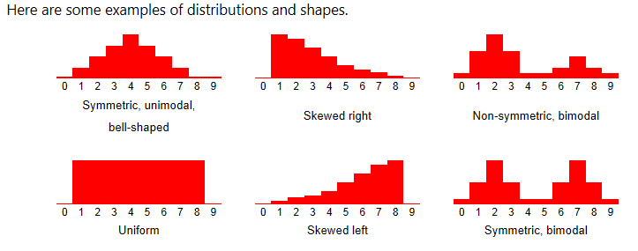

Slide 21
